Slide 1

Purwadhika Auto Insurance
CUSTOMER LIFETIME VALUE PREDICTION
MODULE 3 AND 4 CAPSTONE PROJECT SUPERVISED REGRESSION MACHINE LEARNING MODEL
Qemhal Haritskhayru | DTI DS

Slide 2

BUSINESS BACKGROUND
WHAT IS CLV? HOW CLV HELP THE BUSINESS?
CLV helps identify a potential high-value customers and prioritize retention efforts.
Reduce churn, save on acquisition costs, and foster stronger relationships.
Drive sustainable growth and maintain a loyal customer base.
Purwadhika Auto Insurance

Slide 3
BUSINESS PROBLEM
01
02
COST OPTIMIZATION
CUSTOMER RETENTION
Minimizing customer acquisition costs and reducing churn.
Identifying and retaining high-value customers who are likely to generate significant revenue over time.
03
04
RESOURCE ALLOCATION
PERSONALIZATION
Determining where to invest marketing and service efforts for the highest return on investment.
Tailoring products, services, and pricing strategies to individual customer needs and preferences.

Slide 4
GOAL OF THE ML MODEL
01
REDUCE CHURN
02
IDENTIFY HIGH-VALUE CUSTOMERS
03
OPTIMIZE RESOURCE ALLOCATION
04
INCREASE PROFITABILITY
05
GAIN A COMPETITIVE EDGE

Slide 5
ANALYTICAL AND METRICS EVALUATION APPROACH
STAKEHOLDERS
01
Marketing Manager
Since the goal is to predict a continous numerical (CLV), the approach is to use a supervised machine learning method which is regression model. A number of regression model will be explored such as linear regression, lasso, ridge, KNN, and tree based regressor model.
02
Lead Data Scientist
RMSE
RMSPE
ADJUSTED R-SQUARED
Purwadhika Auto Insurance

Slide 6
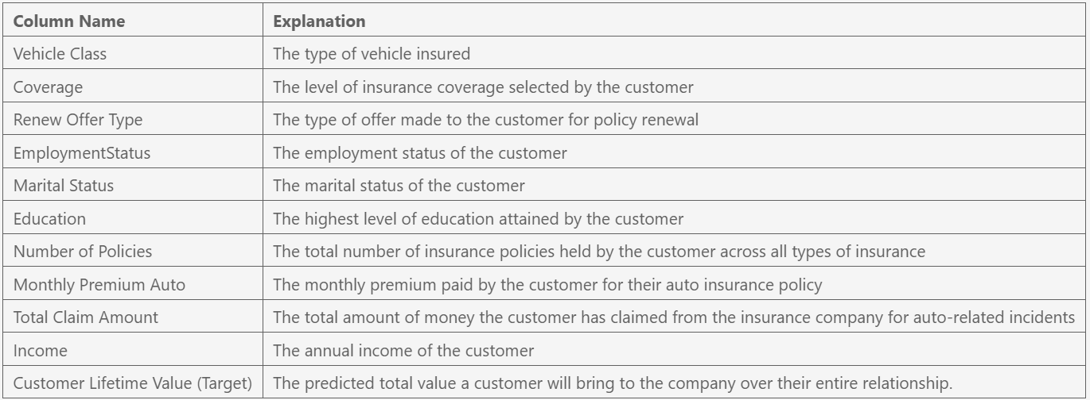
DATA UNDERSTANDING

Slide 7
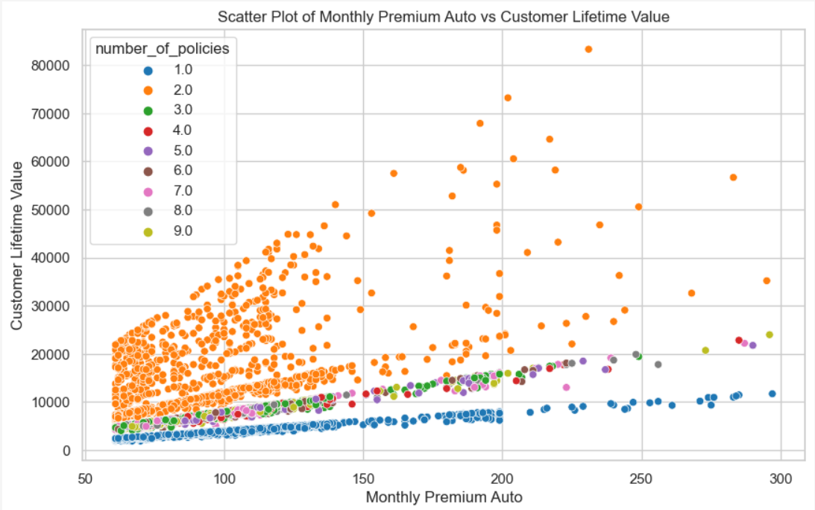

INSIGHTS FROM EDA
NUMBER OF POLICIES FEATURE
NO NULL VALUES IN DATA
620 DUPLICATED DATA REMOVED
499 OUTLIER IN TARGET (CLV)
FEATURES
HIGHEST AVG CLV
Luxury SUV
Premium Coverage
Offer 1
Employed
Married
Master
Hold one
Low CLV
Holds two
High CLV

Slide 8
FEATURE ENGINEERING
OUTLIER
ENCODING
SCALING
POLYNOMIAL
Removing the outlier in target (CLV) above 95 percentile
One Hot Encoding: On features employment status, marital status, and number of policies (only on linear).
Ordinal Encoding: On vehicle class, coverage, renew offer, and education.
MinMax Scalling: On monthly premium auto, total claim amount, and income. Applied only on linear model and KNN.
Applied Polynomial with 3 degrees only on linear models.

Slide 9
ML MODEL RESULTS SUMMARY
LINEAR MODEL
TREE BASED MODEL
Model | RMSE | RMSPE
Lasso | 1773.18 | 18.46
Ridge | 1773.39 | 18.49
Linear Regression | 1773.52 | 18.50
Model | RMSE | RMSPE
Gradient Boost | 1702.73 | 14.18
Cat Boost | 1754.95 | 15.94
Random Forest | 1779.17 | 14.90
LightGBM | 1834.64 | 15.16
XGBoost | 1896.01 | 20.01
Decision Tree | 2348.83 | 20.83
Best Model
KNN
Neighbors | RMSE | RMSPE
3 | 2626.04 | 31.84

Slide 10

GRADIENT BOOSTING REGRESSION: CLV PREDICTION
01
Initial start with weak
models: Decision Tree
02
Calculate residual/error
03
New Model predicts error
04
Combine the prediction
ERROR/
RESIDUAL
05
Iteration
ITERATION

Slide 11
GRADIENT BOOST WITH HYPERPARAMETER TUNING
PARAMETER
RESULT AFTER TUNING
0.05
100
4
5
2
0.9
None
Learning rate
N-Estimators
Max depth
Min sample split
Min sample leaf
Subsample
Max features
Model | RMSE | RMSPE
Base | 1702.73 | 14.18
Tuned | 1668.07 | 13.28
RandomSearch
ADJUSTED R-SQUARED
0.83

Slide 12
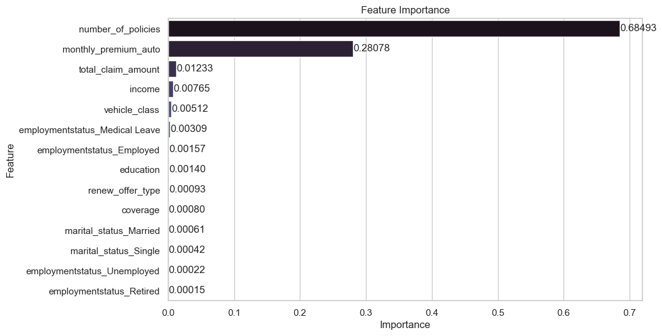
FEATURE IMPORTANCE

Slide 13

CONCLUSION
GRADIENT BOOSTING WITH HYPERPARAMETER TUNING ACHIVE THE BEST SCORE
THE MODEL HAS LIMITATION. USE IT ACCORDINGLY.
NUMBER OF POLICIES HAS THE HIGHEST IMPORTANCE FOLLOWED BY MONTHLY PREMIUM AUTO
CUSTOMERS HOLDS TWO POLICIES EQUAL TO HIGH CLV. HOLD ONE IS LOW CLV.
MONTHLY PREMIUM AUTO INCREASE CLV.
THE MODEL MEATS EXPECTATION.

Slide 14

RECOMMENDATION
UTILIZE IT TO RETAIN CUSTOMERS
UTILIZE IT TO IDENTIFY HIGH POTENTIAL CUSTOMERS
REFINE THE MODEL PERFORMANCE
ADDRESS DATA SKEWNESS.

Slide 15
ML MODEL IMPACT
By deploying this refined CLV prediction model, Purwadhika Auto Insurance can transform its customer management approach. It empowers the company to strategically prioritize retention efforts, nurture high-potential customers, and personalize interactions for optimal engagement. This data-driven approach not only reduces churn and boosts profitability but also fosters stronger customer relationships and long-term loyalty. Ultimately, this positions Purwadhika Auto Insurance as a customer-centric leader in the market, with a sustainable competitive advantage driven by deep customer insights and tailored strategies.

Slide 16
Purwadhika Auto Insurance
THANK YOU
Next: Demo the model ability to predict on Google Cloud Service

